Slide 1
Pre-Live Session 4
AR(2) and AR(p)

Slide 2

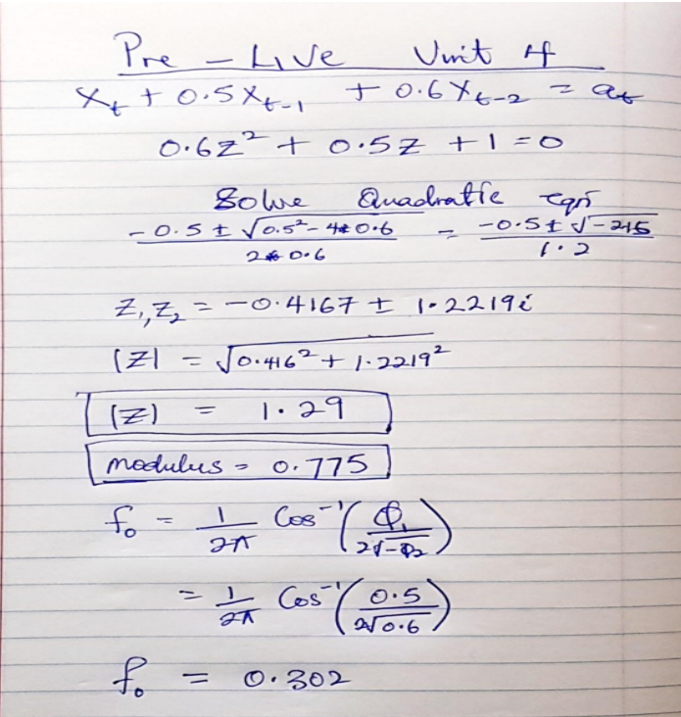
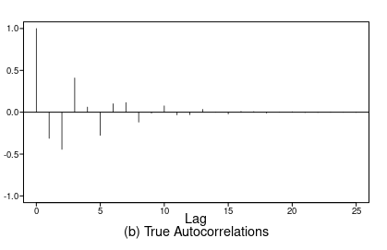
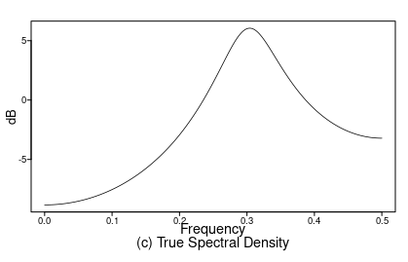
Characteristic Model
This is a Stationary Model

Slide 3
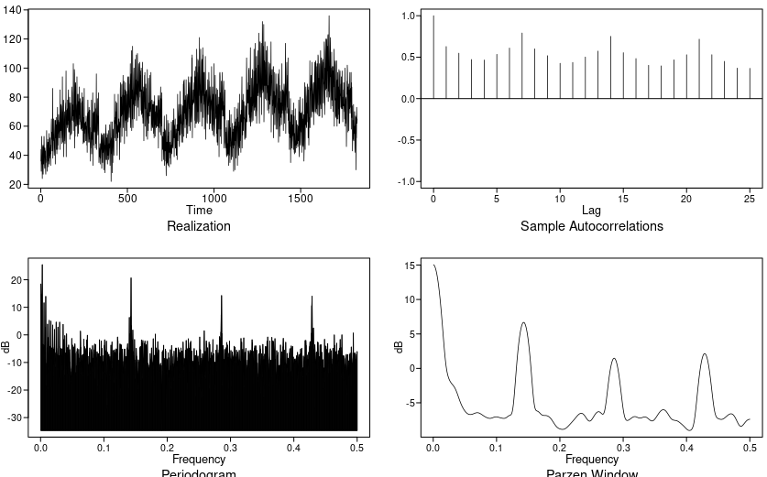
Walmart Data Store 9 Item 50
The above plot shows that the data has a some sinusoidal for the autocorrelation and frequency peaks between 0 and 0.5 but the highest peak at 0 looking at the spectral density. This tells us that the model should have be a model A-r. There are peaks at 0, 0.13, 0.43 and 0.28. We have to look for models that has frequencies close to this.

Slide 4
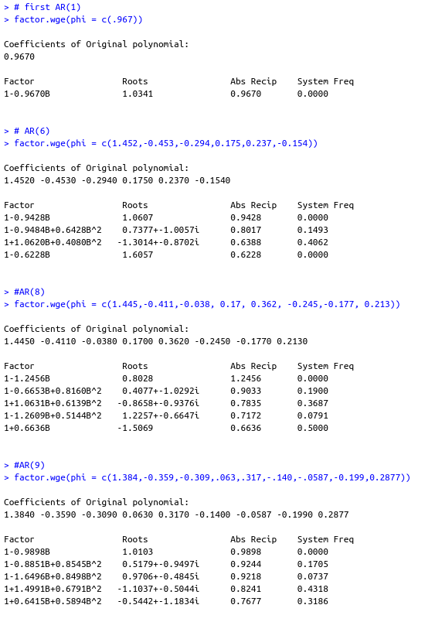
Walmart Data Contd..
Looking at the factor table for all the model provided, the AR(8) model is not stationary so we can eliminate that one. AR(1) model is not complex enough to be a better model than the rest because the is only at 0 peak and the ACF is not sinusoidal which means that it doesn’t have a conjugate root. AR(6) and AR(9) are the only competing model with conjugate roots.
When we look closely at the ACF, AR(9) is the only one with clear visible sinusoidal pattern but AR(6) has the second frequency closer 0.13 and third frequency at 0.40 which is also closer to that of the data at 0.43. So because of that I will give it a better chance at being a better model than AR(9). They both have a top frequency at 0.
The the plots are on the next page.

Slide 5
Takeaways
The fundamental behavior of autocorrelations and spectral density depends on whether the roots of the characteristic equation are real or complex.
A stationary AR(2) model with second degree order whose characteristic equation has complex conjugate roots
  Has realizations that shows a pseudo-cyclic behavior with cycle length about 1/f₀.
  The autocorrelation function has the appearance of a damped sinusoidal with frequency f_{0.}
  The spectral density has a peak at about f₀.
There are 3 types of model with first and second order factor with AR(P):
  Model A: With roots equally close to the unit circle.
  Model A-r: Real root closer to the unit circle than complex roots.
  Model A-c: Complex root closer to the unit circle than real root.
Which ever root that is closer to the unit circle in a AR(P) model would be more prominent in the realizations, functions and spectral densities.
When roots were equally close to the unit circle, we saw both first and second order behaviors.
When the positive real root was closest to the unit circle, the first order behavior dominated.
When complex roots are closer to the unit circle, second order behavior dominates.

Slide 6
Questions
None.

